Slide 1
Online Grocery System
COEN 6312 – Winter 2016
Team: NEOPHYTES
Sandeep Kumar (7172486)
Harmeet Singh (27193114)
Shrijeet Kaduskar (27391773)
Ramandeep Singh (27394675)
Vikas Yadav (27288700)

Slide 2
Content
2
Background and Goals
Gantt Chart
Development plan
Use Case Diagram
Class Diagram
Constraints.
State Diagrams
Collaborating Tools
Lesson Learned
Future Enhancements

Slide 3
Background and Goals
Exploiting UML specifications for system development.
Model different views of the system.
Understanding tools.
Develop reliable, flexible, useful and usable software system.
Platform Independent → Platform Specific
Create simple to use User Interface.

Slide 4
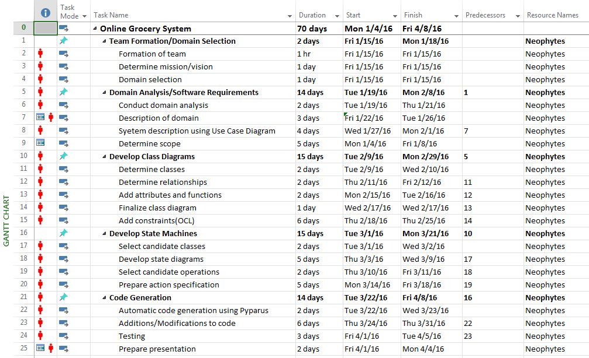
Gantt Chart

Slide 5
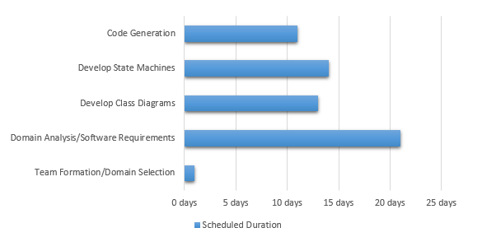
Development Plan

Slide 6
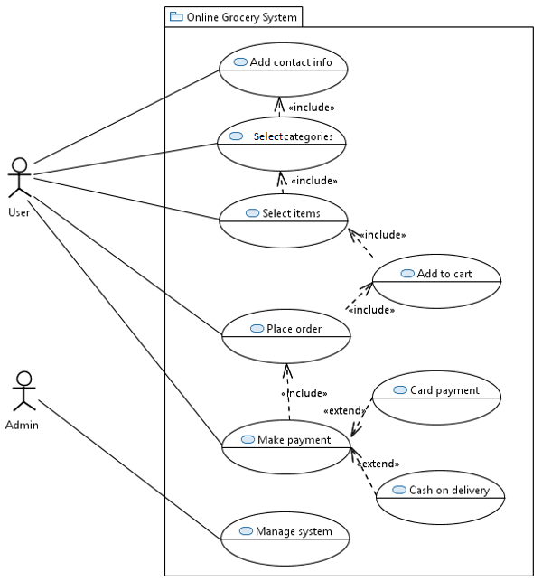
6
Use Case Diagram

Slide 7
7
Class Diagram

Slide 8
8
Constraints
1. Delivery address and postal code cannot be empty.
Context User
inv: self. deliveryAddress ->size()=1 And self.postalcode->size()=1
2. Phone number is a necessity for the delivery.
Context User
Inv:self.phoneNo ->notEmpty()
3. Users and user ids are different.
Context User
Inv: self.userid ->forAll(u1,u2:User | u1< >u2 implies u1.userid< >u2.userid)
4. Minimum order for delivery should be $25.
Context Order
Inv: self.totalAmount >=25

Slide 9
9
Constraints
5. Shopping cart contains all the ordered items.
Context ShoppingCart
Inv: self.consists->includesAll(OrderedItems)
6. Total Amount must include taxes.
Context Order
Inv: self. totalAmount->includes(self.taxes)
7. Payment id must be unique.
Context User
Inv: self.makes->(u1,u2:User| u1<>u2 implies u1.paymentId<>u2.paymentId)
8. If an item is not added to the cart, add item to the cart.
Context User :: addToCart(id:itemId):void
Pre: User.buys->excludes(id)
Post: User.buys->includes(id)

Slide 10
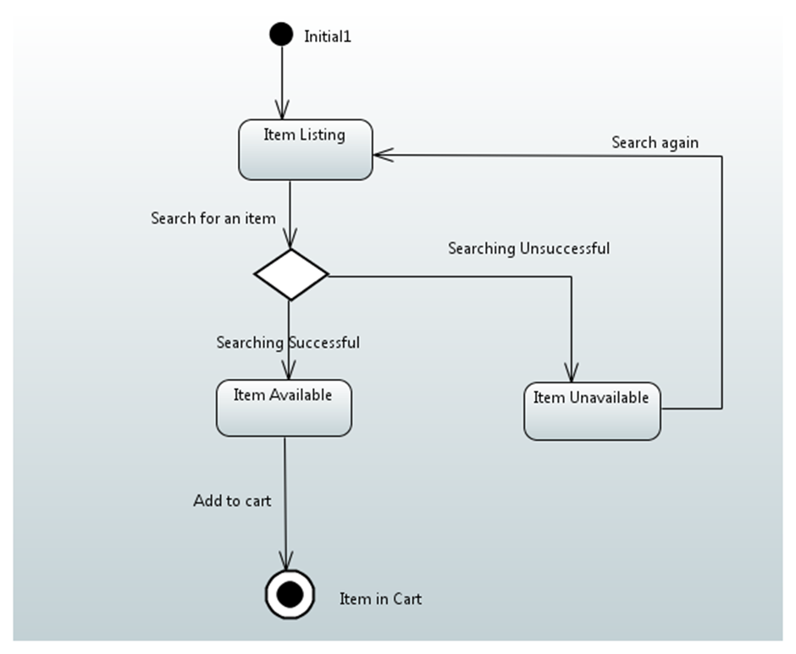
State Diagram 1: Item

Slide 11
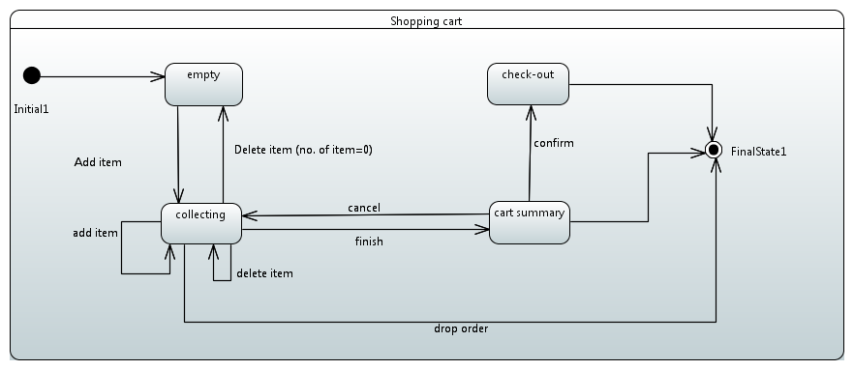
State Diagram 2: ShoppingCart

Slide 12
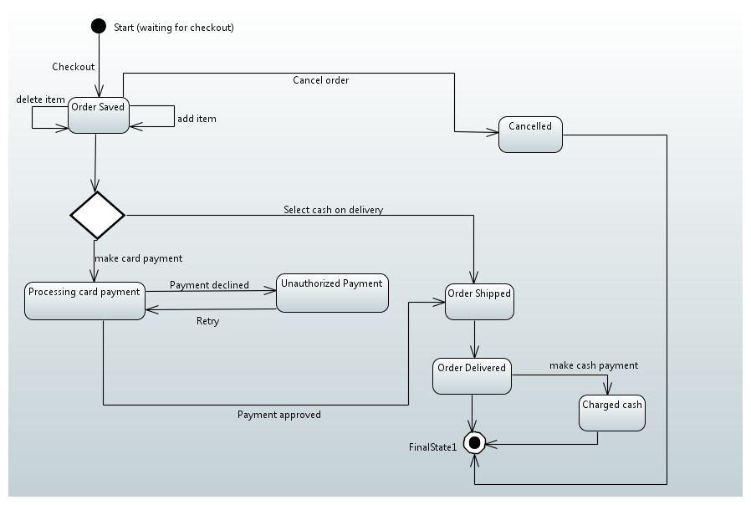
State Diagram 3 : Order

Slide 13
13
Use of ALF
Class: Order; Operation: MakeCardPayment
activity MakeCardPayment()
{
cardPayment= new cardpayment();
cardpayment.Makenewpayment (
customerName =>this.customername,
cardNumber =>this.cardNumber,
cardExpirydate =>this.cardExpirydate,
cardCVVNumber =>this.cardCCVNumber,
billingAddress => this.billingAddress,
paymentAmount=>this.paymentAmount,
);
}

Slide 14
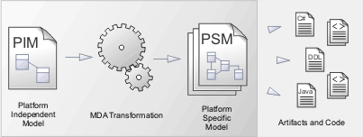
Conversion to Java specific Model
Huge Productivity Boost

Slide 15
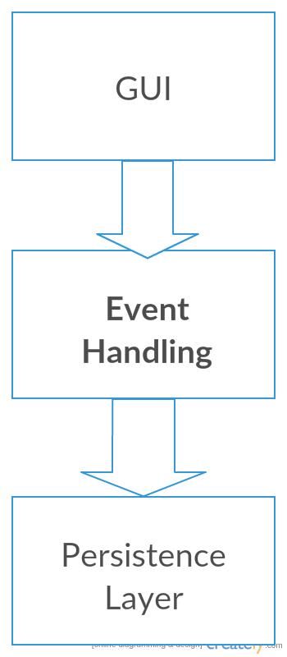
Role of State Diagrams for Conversion

Slide 16
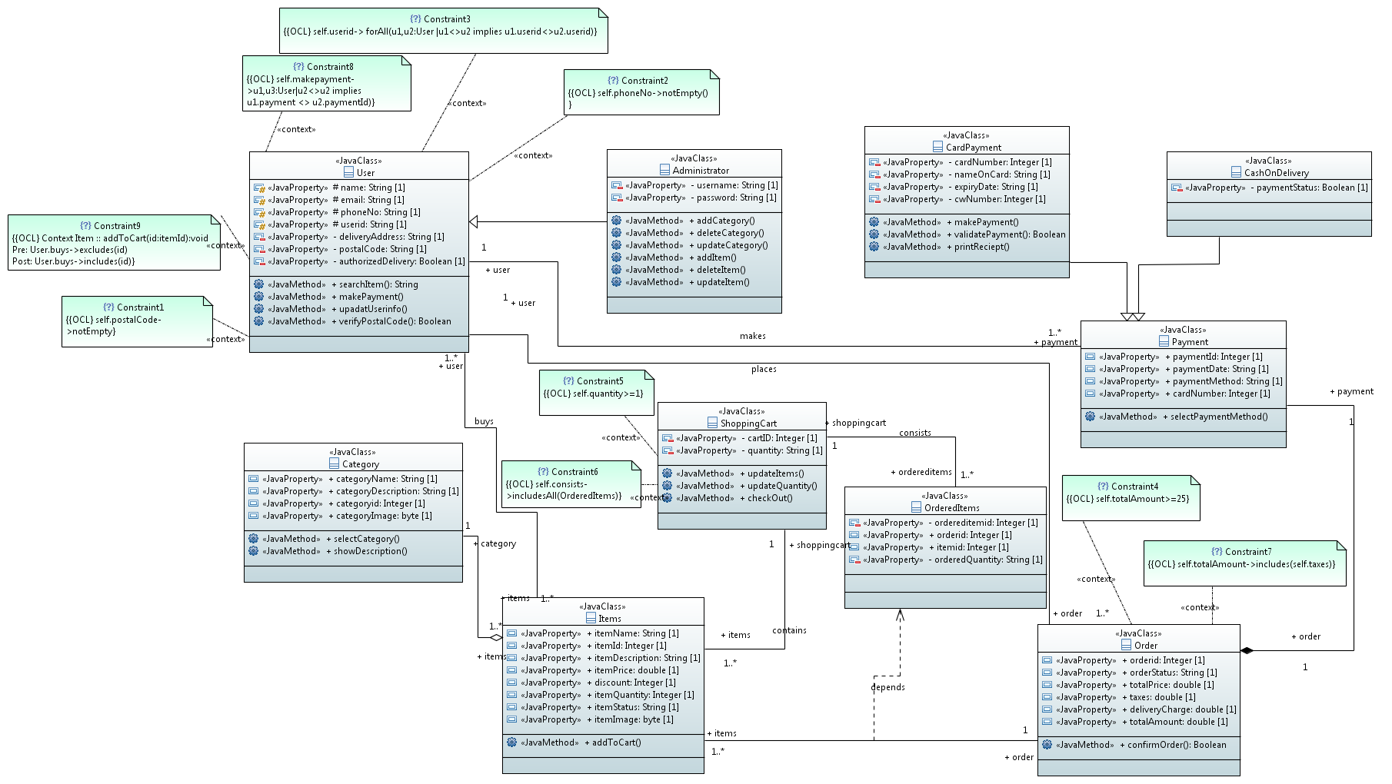
JAVA Specific Model

Slide 17
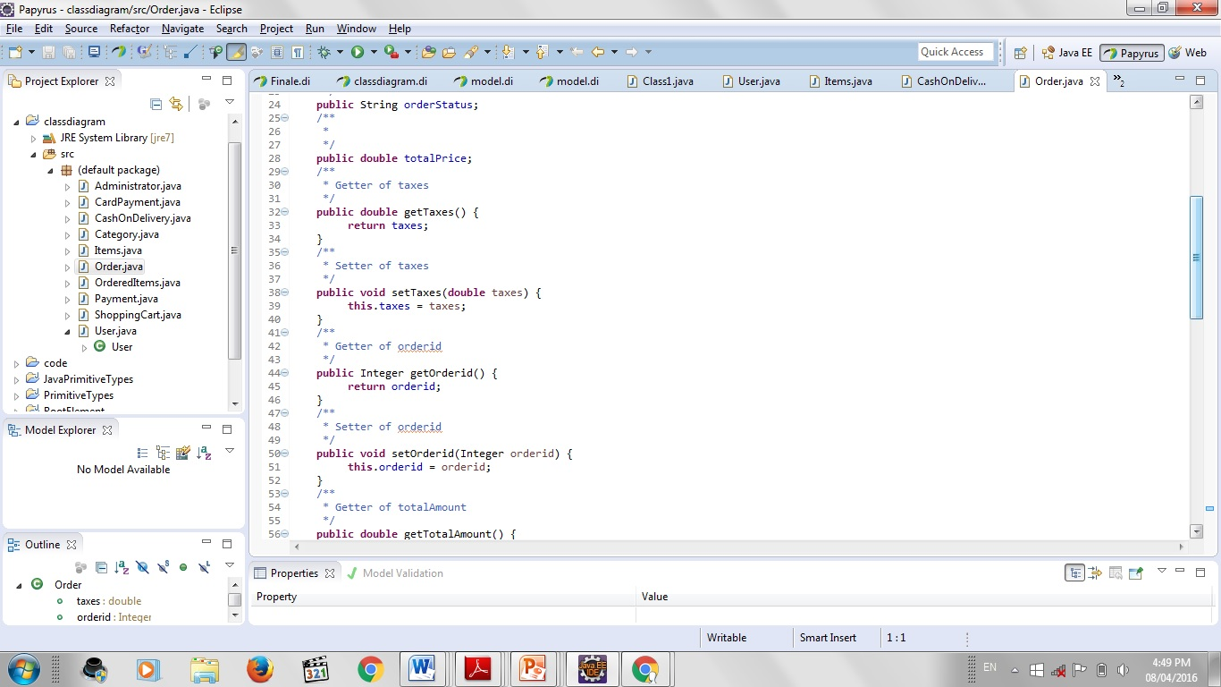
Code Generation using Papyrus

Slide 18
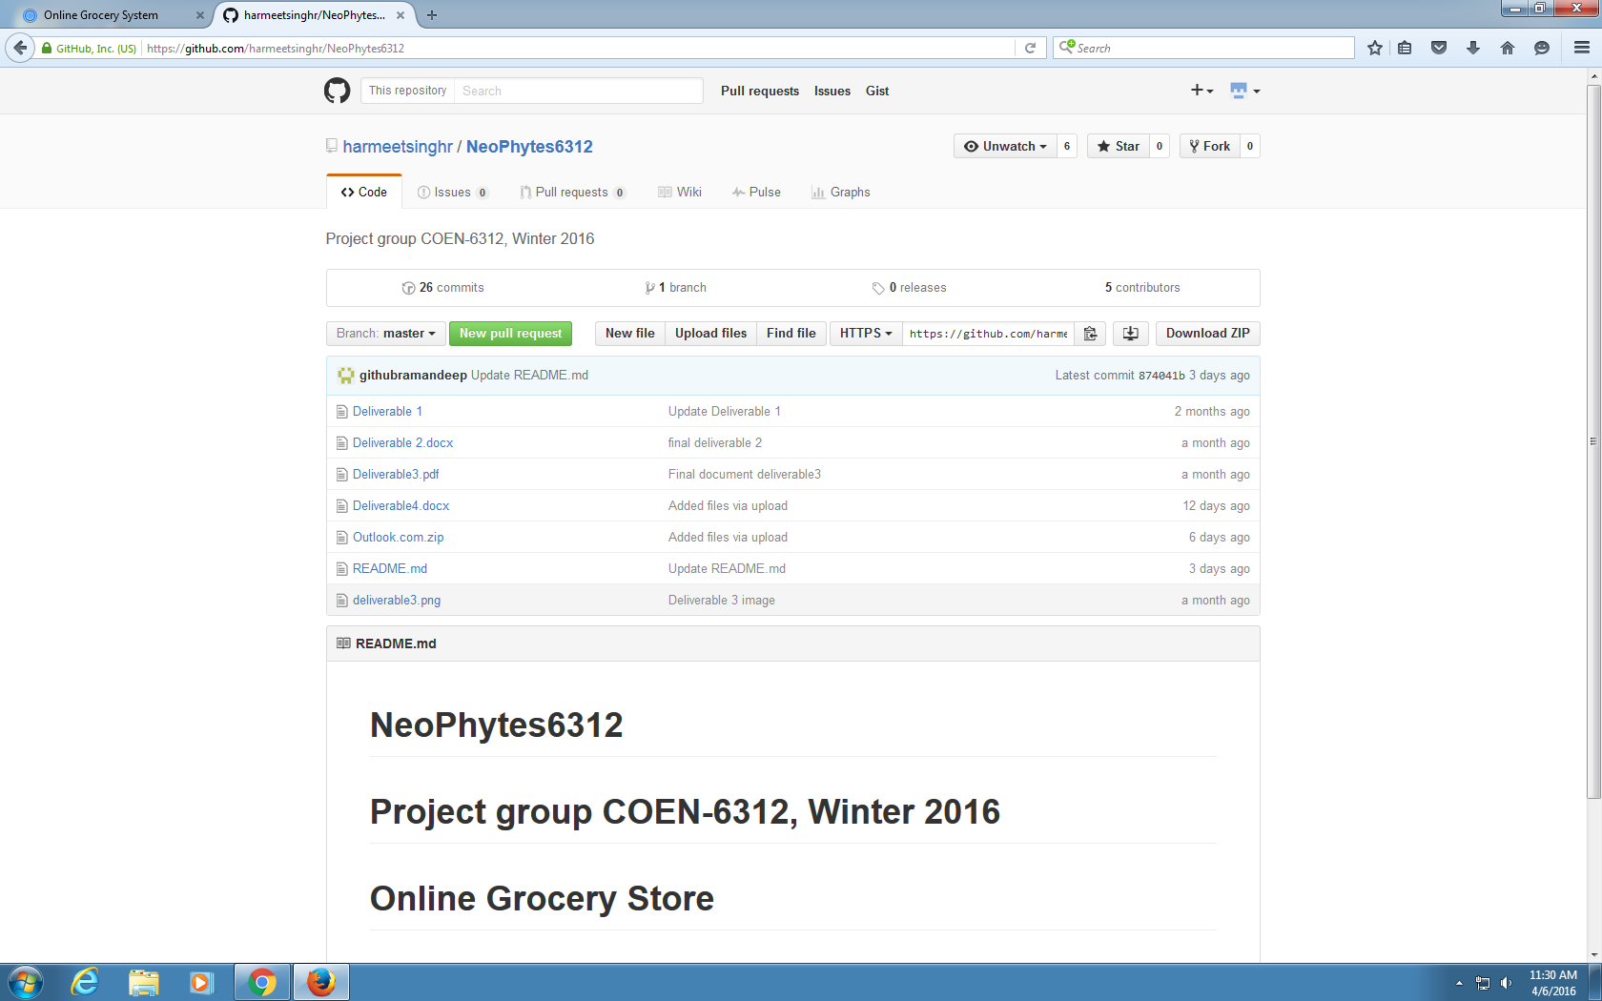
Collaboration Tools - GitHub

Slide 19
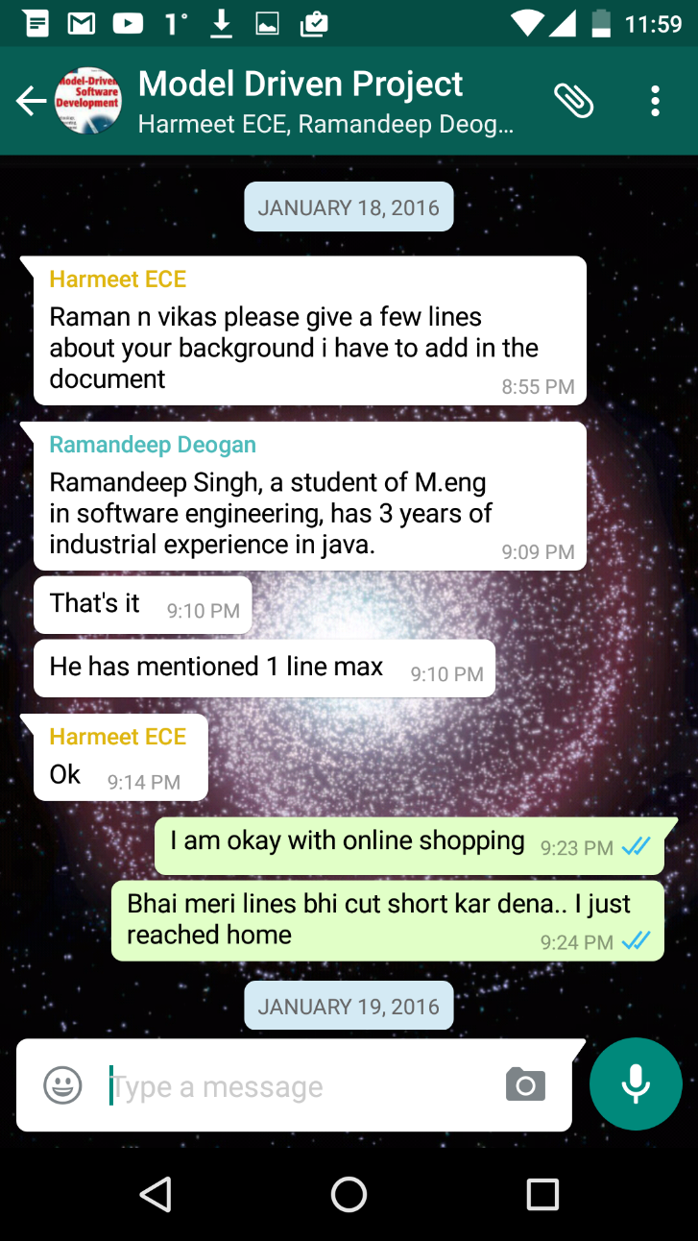
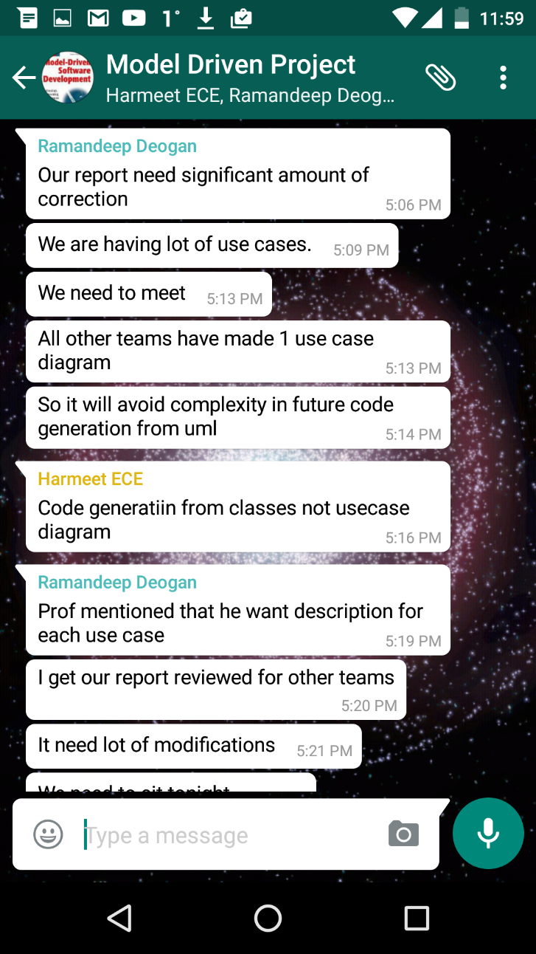
Collaboration Tools - WhatsApp

Slide 20
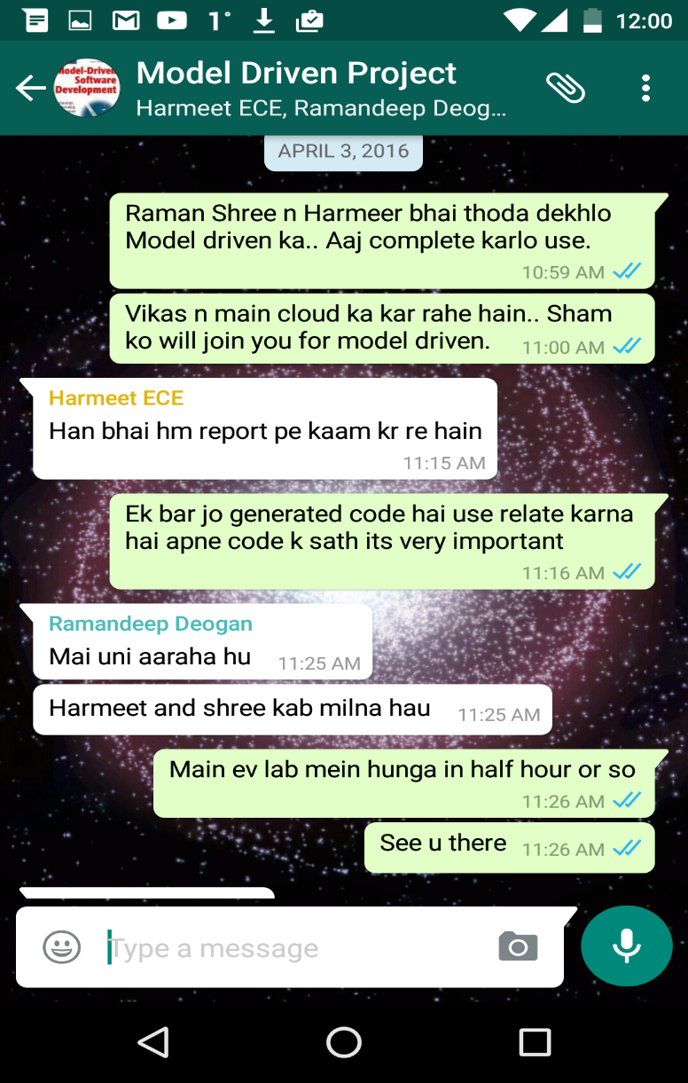
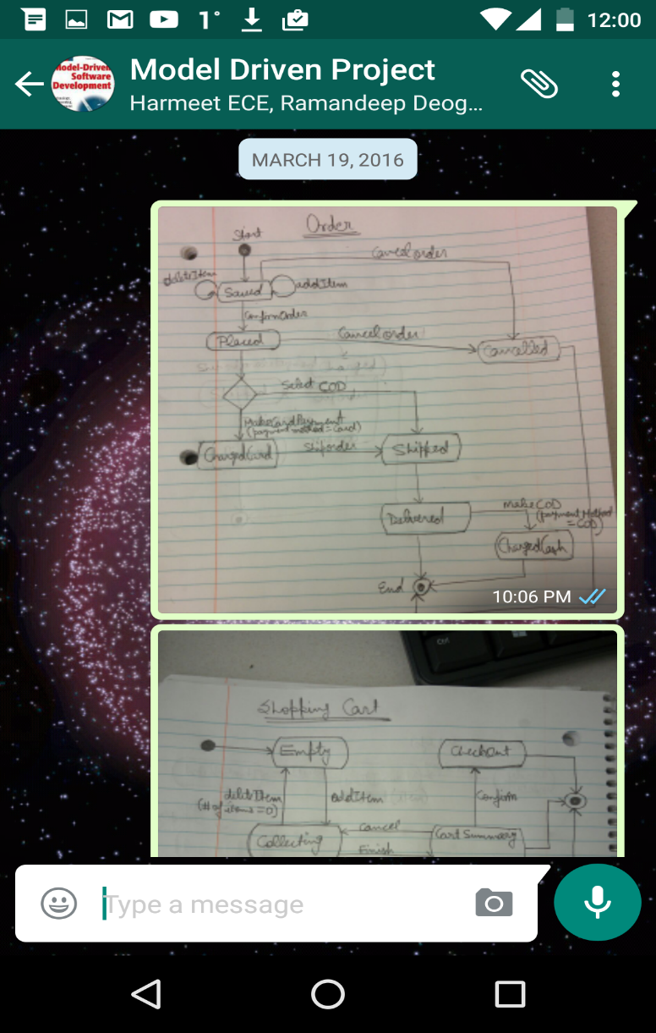
Collaboration Tools - WhatsApp

Slide 21
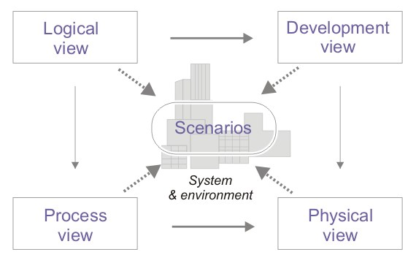
Lessons Learned
MDD emphasis programming on a higher level of Abstraction.
MDD enforces a lot of rigidity (less specification).
UML provides 4+1 Architectural view.
A number of tools on the market generate code, Test and Verification Suites from UML models.

Slide 22
Papyrus Limitations
Code for OCL constraints was not generated even after installing required plugin (Eclipse OCL 6.0.1).
Still need to write code manually by hand.

Slide 23
Constructive criticism
MDD is still an emerging paradigm (not mature).
Very less online support and guidance available for operating tools.
There must be video tutorials and webinars from scratch to develop application using executable UML.

Slide 24

Thank You

